Slide 2
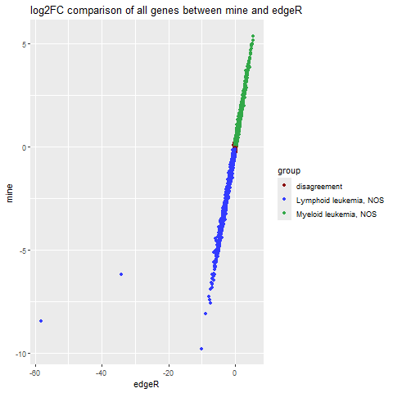
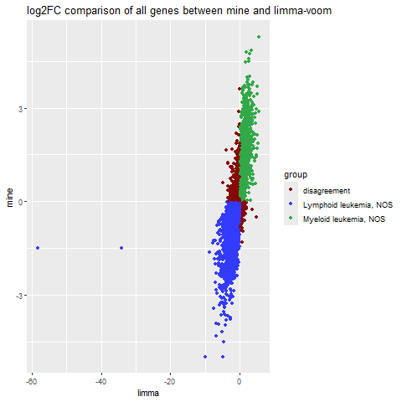
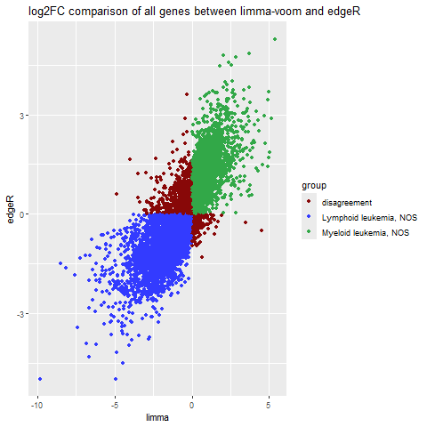
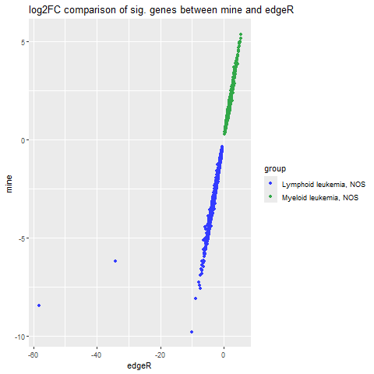
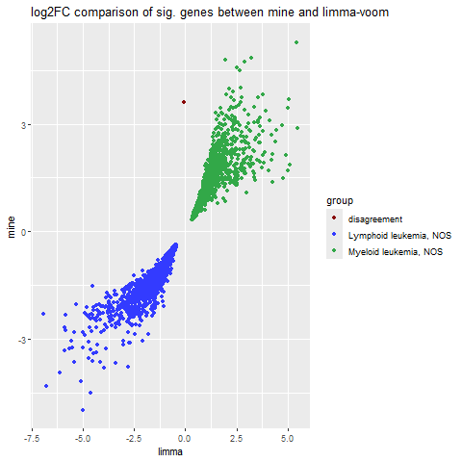
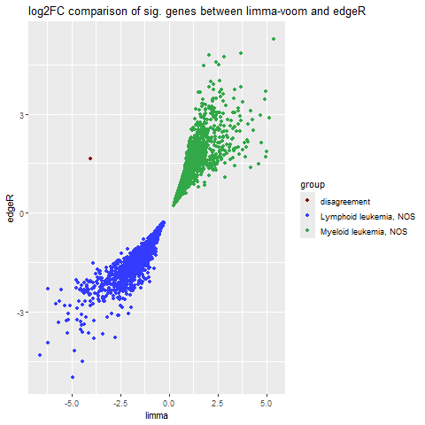
A
B
C
D
E
F
Notes:
Figure 1 Comparison of the logFC between groups between A my algorithm and edgeR, B my algorithm and limma, and C edgeR and limma when comparing all genes. When only evaluating significant genes, D compares my algorithm and edgeR, E compares my algorithm and limma, and F compares edgeR and limma when comparing all genes

Slide 3
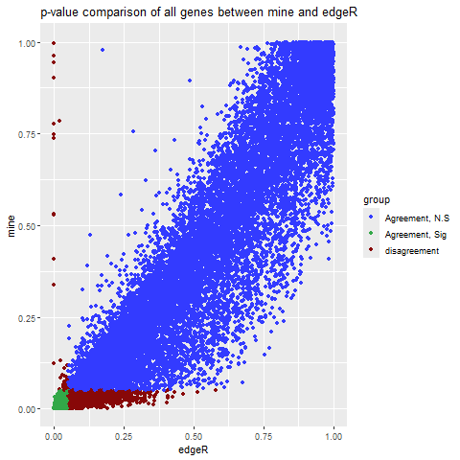
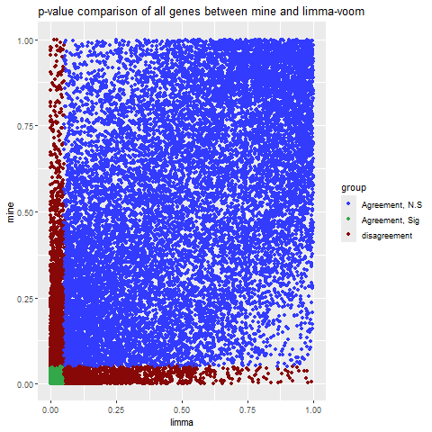
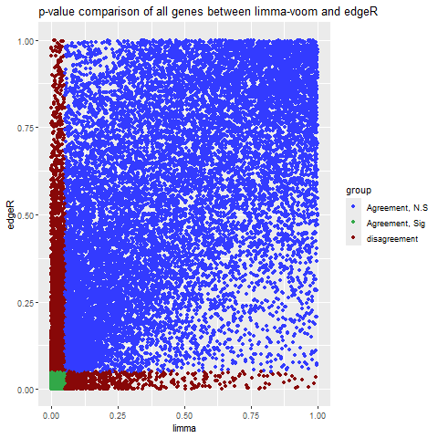
A
B
C
Notes:
Figure 2 Comparison of the p-value between groups between A my algorithm and edgeR, B my algorithm and limma, and C edgeR and limma when comparing all genes.

